Slide 1
Lazy_Pandas Toyathon Challenge Presentation “Flight Tracker” by Suhesna Basu & Rahul Kumar Prajapati

Slide 2




Asansol Engineering College
Vivekananda Sarani, Opp. Jubilee Petrol Pump Kanyapur, Asansol, West Bengal 713305
Department of
Electronics & Communication Engineering
Member Contribution
Being a Full Stack Developer and an avid Python programmer my contributions include helping with the idea implementation and suggesting the future scope for our Flight Path project.
Suhesna Basu
2017 - 2021 Pass out batch
Vsap-2020 finalist
Intern – Full Stack Developer
At Virtusa

Slide 3

Techno International New Town
Block- DG 1/1, Action Area 1,
New Town, Rajarhat, Kolkata - 700156
Department of
Electronics & Communication Engineering
Member Contribution
As an ML and AI enthusiast and an avid Python programmer it was my job to look for relevant computer vision applications and figure out the relevant computer visions applications that can be distilled into a toy for children.
Rahul Kumar Prajapati
2017 - 2021 Pass out batch
Vsap-2020 finalist
Intern – AI & ML Engineer
At Virtusa

Slide 4
“I just keep it simple. Watch the ball and play it on merit.”
— Sachin Tendulkar

Slide 5
INTRODUCTION
Our mission
To essentially make a child get accustomed with the idea of playing with a ball and gamify playing with a ball for children under 5 years.
A ball is the simplest toy that exists. It is the essentially low cost, harmless and already exists in most homes.
And essentially combining what they already have with them with recent advances in computer vision to get them the physical exercise that they are missing out during pandemic.

Slide 6
Objectives
Here’s a look at what motivated us to make this project
“Monotony of playing with a ball”
Children under 5 have a small attention span and tend to get bored and so often require interactive toys to keep them engaged which may not be cost effective.
“Busy Parents ”
Small children often require their parents to play with them for longer durations which may not be possible due to work engagements.
“Lack of Hybrid Games”
Even after recent technological engagements there are very few interactive games that combine both physical aspects and technological aspects to cater physical exercise needs for children.

Slide 7
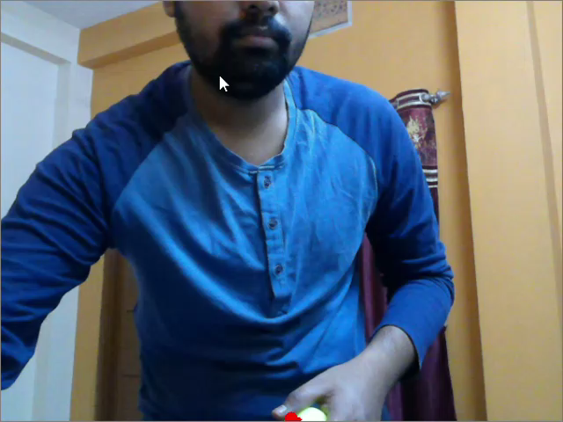
Demo of Flight Tracker

Slide 8

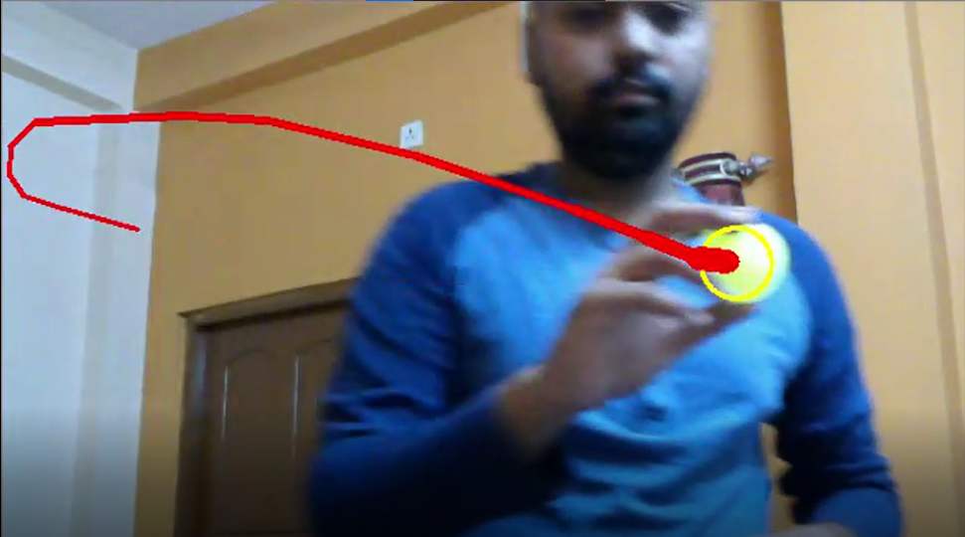


Project analysis slide 10
Technology Used
The entire project is written as an executable python script with plans to deploy the project in an app or web format.
OpenCV is a library of programming functions mainly aimed at real-time computer vision. We used OpenCV’s python wrapper in our project since the original project is in C++.
imutils
A series of convenience functions to make basic image processing functions such as translation, rotation, resizing, skeletonization, and displaying Matplotlib images easier with OpenCV and both Python 2.7 and Python 3.

Slide 9
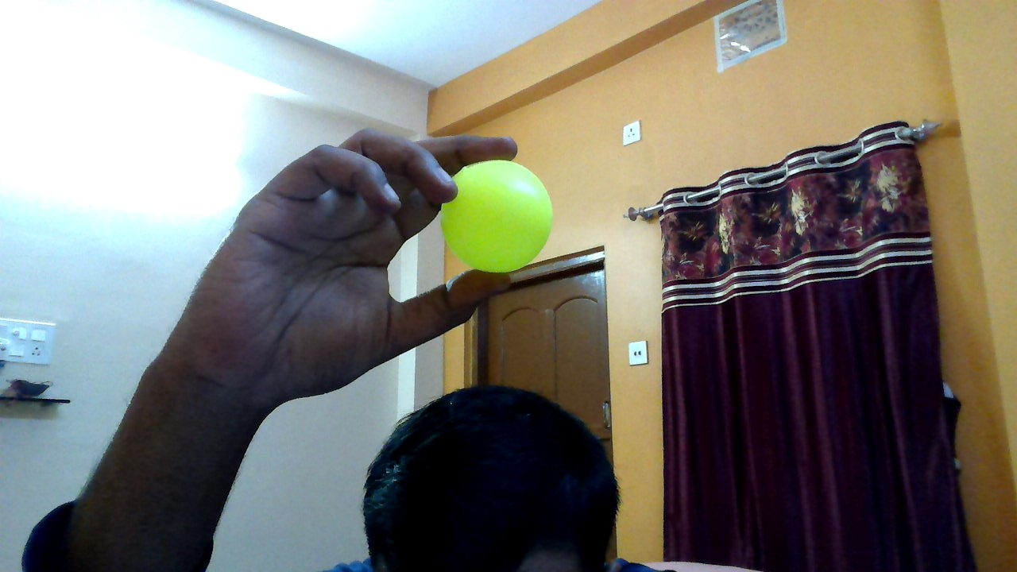
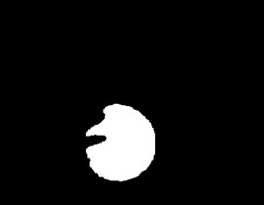
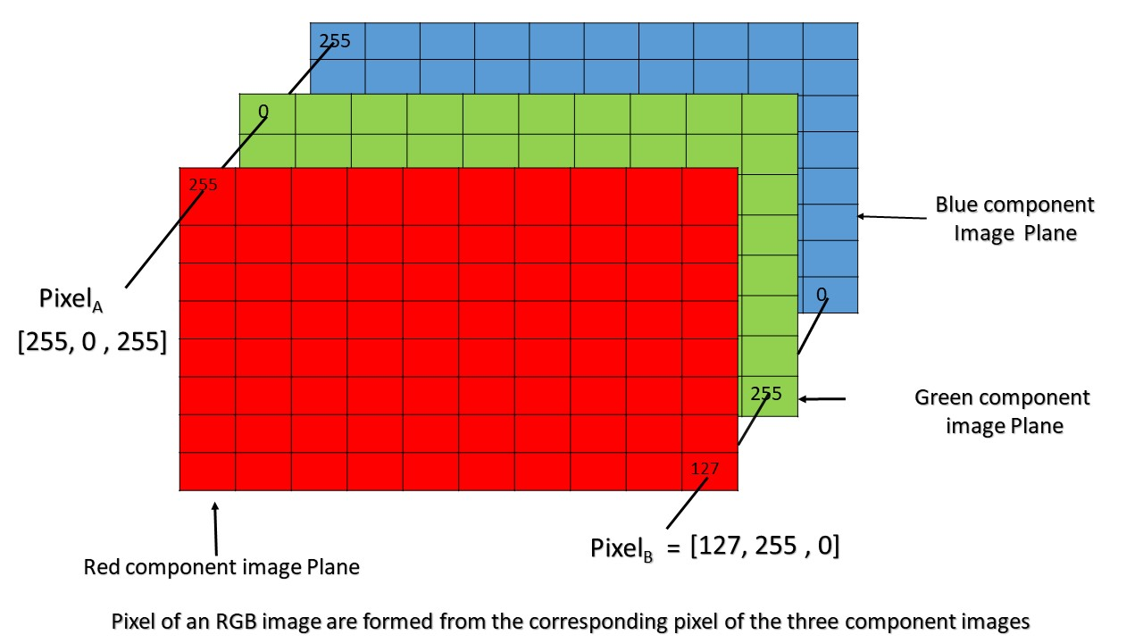
Project analysis slide 4
Basics of control flow Flight Tracker
Apply Mask and plot path
64
Generate Image Mask
[]
64*64*3 = 12288
Final Video Stream
64
246
150
200
100
40
150
30
.
.
Example: Matrix representation of one channel of one frame from streamed video
X =

Slide 10
Advantages of Flight Tracker
1
2
3
4
5
The game is low cost and uses toys present in every home.
It involves physical movements and so is more beneficial to children rather than normal games.
The game is open to imagination.
The tools and the script can be further packed in either a website or app container for easy distribution.
The game itself can serve as a framework to design and develop more AR games on top of it.

Slide 11
Thank You
Lazy_Pandas
“Flight Tracker”

